Slide 1
How Might We help families to get a peace of mind from dementia patients?
75/100
9/10
Your team identified an important problem, but your solution is very similar to many which are available in the market. How can you survive in the red ocean?
Group 5

Slide 2
Target Market
Target Segment
Users: dementia patients, including Alzheimer Dementia(AD), Vascular Dementia(VaD), Mild Cognitive Impairment(MCI), etc.
Most patients are elderly (age>=65)
For the age range of 40 to 64, prevalence is just ranging from 0.15% to 0.87%, neglected in the estimation see appendix reference J
Buyers: caregivers, including elderly homes, hospitals and households
Jobs
Patients
Functional:
Remember everyday tasks such as taking medicine
Remember the path back home
Perform tasks according to their daily schedules
Emotional:
Feel less dependent on their caregivers
Social:
Commute by themselves
Caregivers
Functional:
Reduce the risk facing by patients, including
getting lost
placing in dangerous environment
Assist patients to perform daily tasks to ensure their mental and physical health
exercise
meet friends
Focus on their work
Emotional:
Get a peace of mind

Slide 3


Customer Profile
5/5
Age: 20-65
Age: above 65
Dementia Patients (Alzheimer Dementia(AD), Mild Cognitive Impairment(MCI), Vascular Dementia(VaD), etc. )
Working condition: middle to high income group ($5000+/month)
Working condition: retired
Family condition: have a
patient at home to take care
Family condition: have children that take care of them
Users
Buyers
Did not employ a caretaker for the patient
Want a sense of independence and freedom while knowing that they are safe
Busy working for their salaries
Close relationship with caregiver
Care about the patient

Slide 4
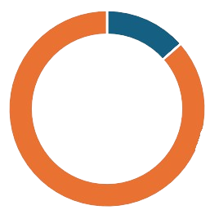
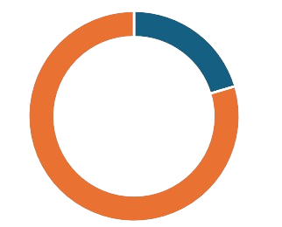
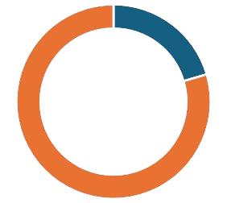
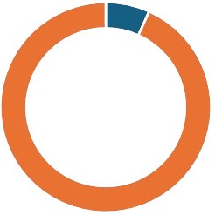
Market size – Greater Bay Area & Hong Kong
of GBA population is above or equal to 65 years old
GBA_age_distribution.xlsx (Ctrl + Click for window) & appendix reference B
of elderly population is suffering different kind of dementia and MCI
dementia_percentage.xlsx & appendix reference C, D
86.62M¹
GBA Population
see appendix reference A
8.64%²
20.39%³
of Hong Kong population is above or equal to 65 years old
see appendix reference F
of Hong Kong elderly population is suffering dementia
reasonable estimation, base on the 5-8% estimation from CUHK 2020, see appendix reference G
7.5M⁴
Hong Kong Population
see appendix reference E
20.47%⁵
6.75%⁶
Main hypothesis:
Most of dementia patients keep a certain level of ability of thinking
Portion of young dementia patients is negligible
Number of dementia patient is predicted to grow due to the ageing population

Slide 5
Your solution may work for the early-state dementia?
Pre-dementia or early-stage dementia. In this initial phase, a person can still live independently and may not exhibit obvious memory loss or have any difficulty completing regular tasks. Mild dementia symptoms mimic episodes of age-related forgetfulness.
Moderate or middle-stage dementia. Moderate dementia symptoms significantly affect a person’s personality and behavior. Someone with middle-stage dementia will generally need full- or part-time caregiver assistance with regular day-to-day activities. Other moderate-stage dementia symptoms include significant cognitive impairment and mood swings.
Severe or late-stage dementia. The final phase is associated with severe cognitive impairment along with a loss of physical abilities. Late-onset dementia symptoms are pronounced memory loss, incontinence, and an inability to move without help.

Slide 6
Market size – TAM SAM SOM*
15/20
TAM (GBA)
= GBA population x GBA elderly(age>=65) fraction x GBA dementia and MCI fraction x price
= 86.62M x 8.64% x 20.39% x $200
= 305M
TAM
$305M
20.27% may be too high if your customers are at the early stage
SAM (Hong Kong)
= HK population x HK elderly(age>=65) fraction x HK elderly dementia fraction x price
= 7.5M x 20.47% x 6.75% x $200
= 21M
SAM
$21M
Your solution possible only work for p
SOM
= SAM x obtainable fraction
= 21M x 10%
= 2.1M
SOM
$2.1M
* all figures are completely based on the previous slide

Slide 7
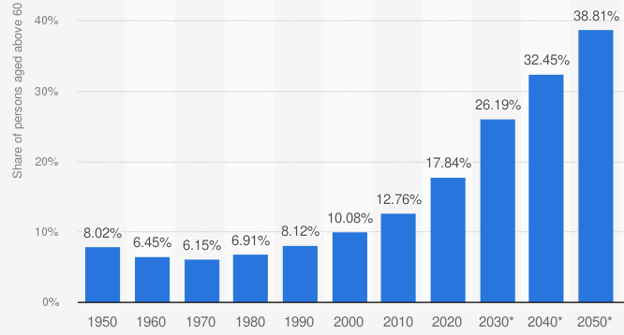

Market potential – Increasing elderly fraction and amount with dementia
According to the graph, from 2020 to 2080, increase by 20.26 percentiles, increase to 218% of 2020 level
While China is estimated to have 1.31billion of population in 2050, comparing to 1.42 billion in 2020, it shrinks by 7.75%
See appendix reference I
Overall, the elderly market size is estimated to increase to be 201% of 2020 level
(1 x (1-7.75%) x 218%)
In the other words, in 30 years, the market size would increase by 100%, and reaches 610M of TAM
Assumption: The fraction change in above-60-elderly is similar as the fraction change in above-65-elderly, which is our market size target
Share of population aged 60 and older in China from 1950 to 2020 with forecasts until 2050

Slide 8
Empathy Map – dementia patients
9/10
I felt like I couldn't do anything. Gradually, I shut myself up in my own world. ^{1,2}
What am I doing now?
The "certainty" in my life is diminishing, and I need to keep checking in. ^{1,2}
What am I supposed to do?
Where am I?
Where should I go?
SAYS
THINKS
FEELS
DOES
Do not speak much ^{1,2}
Become a burden for others ^{1,2}
Afraid to speak up because we don't want to annoy others ^{1,2}
Forget to do daily tasks ³
wander aimlessly ^{1,2}
losing my self-confidence ^{1,2}
Do the same task repeatedly^{1,2}
Afraid that I would bring trouble to my caregiver ^{1,2}
Keep repeating the same phrases ^{1,2}
I couldn't differentiate dream and reality ^{1,2}

Slide 9
Empathy Map - caregivers
It’d be better if I can track their location when I am working
Please be safe
What is he/she doing now?
I want to ensure their (patients) safety
Where is he/she?
Could he/she perform the tasks well?
SAYS
Why you always forget things!
THINKS
FEELS
DOES
Want effective communication with the patient
Call the patient to remind them of important tasks
Distracted from work
Burdened by the patients occasionally to check their information, or remind them
Keep track of all information of the patients in case they forget
Worried about the conditions of the patients
Constant checking on the patients’ current situation

Slide 10
Needs and Gains
13/20
Caregivers
Patients
Gains
Get peace of mind knowing that the patient is safe
Minimize their time on constantly reminding the patient of daily tasks
Make sure the messages to patients are well received
Cheaper alternative to daycare services, elderly homes or caretakers while still ensure the patients’ safety
Gains
Wearable device that minimizes the chance of forgetting to bring it along
Can perform tasks more independently without disturbing their caregivers
A timely portable reminder
Needs
Need to take care of patients
Need to focus on their work
Real-time location tracking in case of emergency
Needs
Need to be reminded of tasks such as taking medicines, medical appointments
Need guide in case of dementia to lead back to safe locations

Slide 11
Solution
Your solution is very similar to many available in the market. How do you compete in the market?
Functional Features
Proactive guide
Conditionally pop-up assistant
Guide the user to one of the preset locations, e.g., home
Timely reminder
Pop up notifications according the schedule
Collaborative schedule
Caregivers, including family, can help construct the daily schedule for patients through their phones
Informative tracking to caregiver
Synchronized geographical information will be displayed on caregivers’ devices
Gain creators
Proactive guide ensure the safety and security of users with the risk of getting lost, allowing them to go back safety zone by themselves
Timely reminder and collaborative schedule help user to remember and perform daily administrative tasks
Pain relievers
Informative tracking allows caregivers to give a real time locational care to patient and certainly releases their worries during working
Water-proof wearable device to minimize the chance of forgetting to bring it along

Slide 12
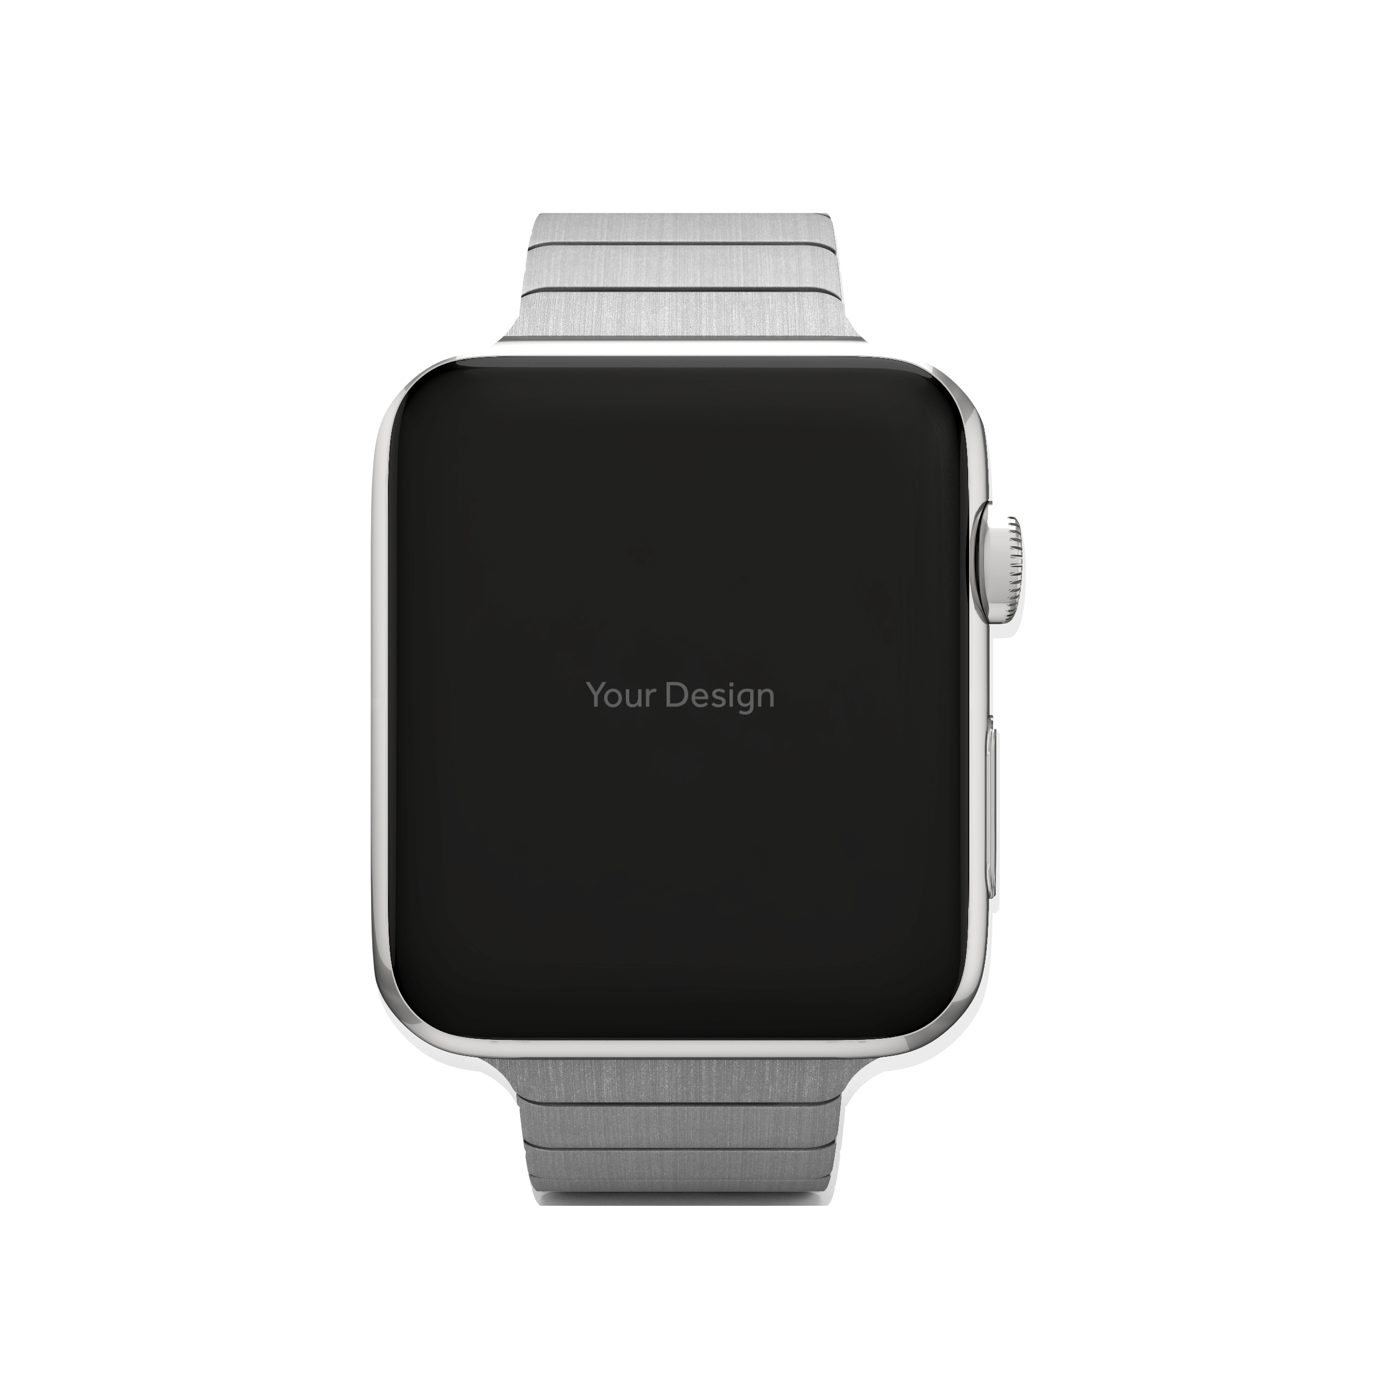
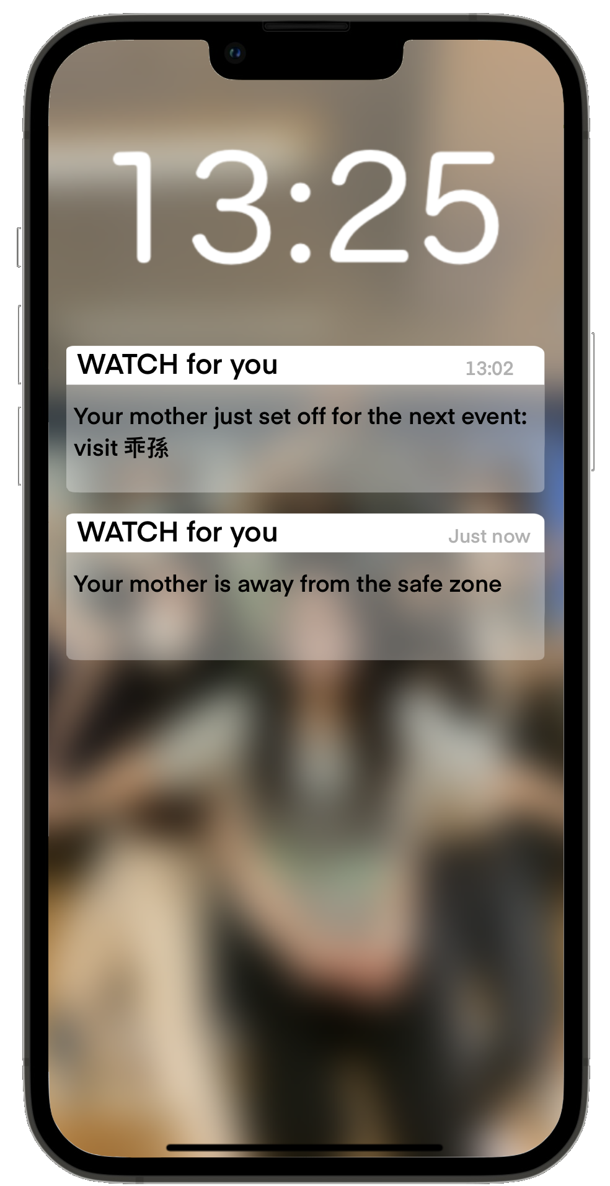
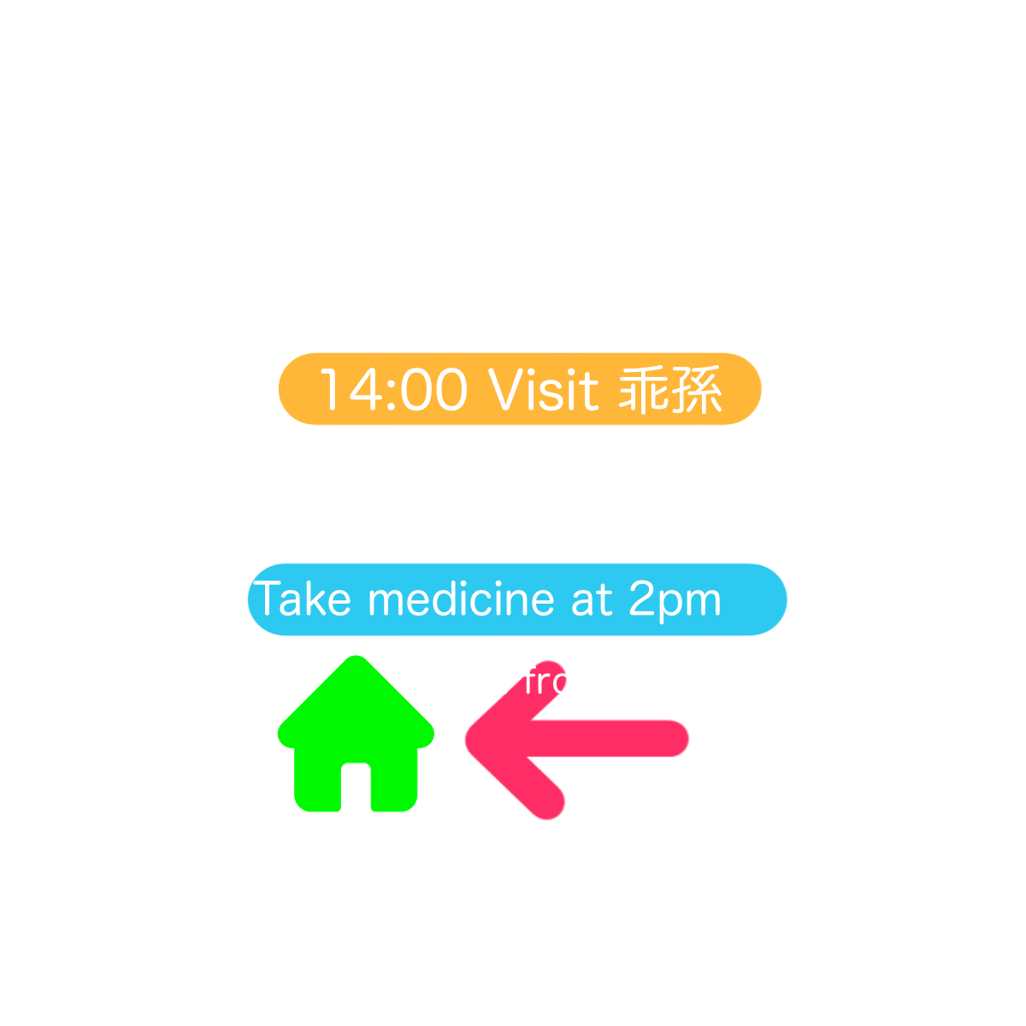
What is the most unique feature of the watch? price?
Solution - Configuration
12/20
No touchscreen – reduce the power consumed, more elderly-friendly
Speaker – to instruct the elderly by vibration / sound
Solar-powered battery with long battery life
They have to go outdoor?

Slide 13
Solution – How it works?
12/20
Collaborative Schedule
Both the family and the patient can add event such as medical appointment to the schedule which syncs in both the smartwatch and the family’s mobile app
One upcoming event will be displayed at a time to remind the patients of what they are doing
Timely Reminder
Constantly reminding the patients of what they are doing, where they are heading according to the imported schedule
Display important messages sent from their family with vibration according to the time of delivery set by their family
Informative Tracking
Real time geographical information will be displayed on the family’s mobile app

Slide 14
Solution – How it works?
Proactive Guide
When the user (patient) walks out of the preset safety zone, or not at home for a prolonged period of time, a notification will be sent to the family’s mobile app
Conditionally, assisting questions and sound notifications would be popped up to see if the user has gotten lost and needs help
Proactive Guide is enabled automatically to lead the user back to the safety zone (pre-set locations), or back home by easy commands like “turn left”, with an arrow showing them the direction they are heading, and the direction they should go
How long is the prolonged period?
How? What about the danger on the road?

Slide 15
Competitors analysis
Direct competitors
Indirect competitors
Product | WATCH for you | AngelSense | Jockey Club Caring Communities | Elderly Caretaker Home
Feature 1 | Provide safety zone settings | Provides timeline of location, routes, and travel speed | Track users when they are near 5 bus termini | Provides living space and caretaking
Feature 2 | Sent alert and guide user back to safe zone | Sends alert when user is at an unfamiliar place | Caregivers enable “Report Lost” to track the user’s location | Staff will be taking care of the elderly 24-7
Type of Gadget | Watch | Watch | Mobile App | N/A
User Target | Dementia Patient | Children | Dementia Patient | Questionable Reputation / Social Stigma
Technology | Beidou / GPS | GPS | Crowdsourcing with Bluetooth | /
Pricing | $200 | $1792HKD + (350-500HKD monthly) | Free with application | $9000HKD per month
https://www.ourparents.com/products-for-seniors/watches-for-seniors-with-dementia
https://www.alzproducts.co.uk/day-date-talking-watches-dementia-alzheimers

Slide 16
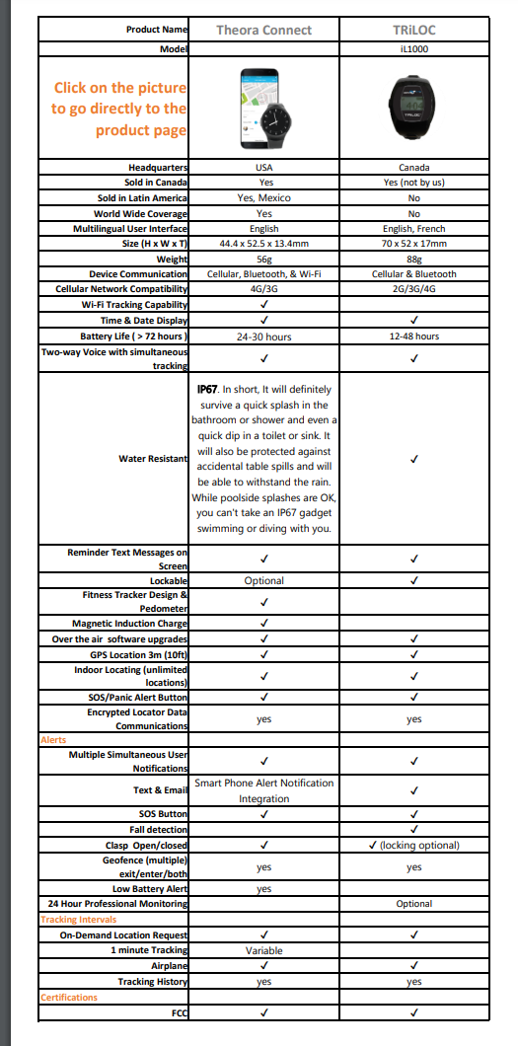
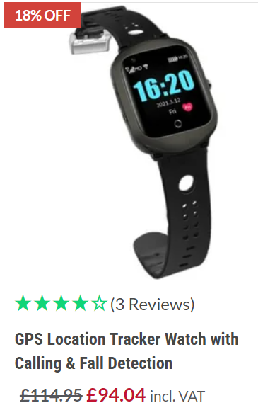
https://www.alzstore.com/v/vspfiles/pdfs/Alzheimers_Store_GPS_Tracking_Watches.pdf
https://www.gftechnovation.com.hk/en/smart-care/anti-wandering

Slide 17
Appendix – references & attributions
Market Size
A https://www.statista.com/statistics/1172165/china-population-in-the-greater-bay-area-cities/
B https://www.edb.gov.hk/attachment/en/curriculum-development/kla/pshe/references-and-resources/geography/Population_E.pdf
C https://www.sciencedirect.com/science/article/pii/S2468266720301857?via%3Dihub
D https://www.qk.sjtu.edu.cn/jdcp/CN/10.16150/j.1671-2870.2021.04.001
E https://www.statista.com/statistics/316842/hong-kong-mid-year-population
F https://www.statista.com/statistics/604594/age-distribution-in-hong-kong
G https://www.openaccessgovernment.org/dementia-as-a-public-health-issue-in-hong-kong/80451
H https://www.statista.com/statistics/251529/share-of-persons-aged-60-and-older-in-the-chinese-population/
I https://database.earth/population/by-country/2050
J Page 39 https://iris.who.int/bitstream/handle/10665/344701/9789240033245-eng.pdf?sequence=1
Empathy Map
1 https://www3.nhk.or.jp/nhkworld/en/tv/documentary/20200223/4001348/
2 https://www.facebook.com/watch/?v=1361106411069820
3 https://youtu.be/x9X75voKB5w?si=c1aIuR7oHC9u_zaz
Image by qeaql-studio on Freepik
https://www.freepik.com/free-psd/smartwatch-presentation_869739.htm#fromView=search&page=1&position=7&uuid=d33e79d3-02bb-4da8-bdf4-938fdfac308c
Old icons created by Freepik - Flaticon
https://www.flaticon.com/free-icons/old
Parents icons created by Freepik - Flaticon
https://www.flaticon.com/free-icons/parents

Slide 18
Is the problem worth solving with good market potential? What is the target market? What is the estimated size of the market (Use TAM, SAM and SOM with appropriate assumptions)? (20)
Present the customer profile (a detailed description of your current customers, including information such as purchasing behaviours, demographic data, and psychographic data (5).
Show an empathy map (10)
Synthesize your empathy findings into needs and gains. (15)
Define a HMW statement (How might we............?). (10)
Describe your solution and list the product features. (20)
It would be useful us for to review your product idea if you provide some sketches of it.
Explain how your product/service works in 3 to 4 simple steps. (20)
Market size / potential: howard
Customer profile: matthew – (please also research on some ideas on why are they not using a cane)
“Canes and walkers are associated with weakness, aging, and dependency. That's often the last thing an elderly person wants to be associated with, especially as the realities of growing old become more intrusive every day for them. Many seniors would rather not go anywhere than to go with a mobility aid.”
Empathy map: matthew
Needs and gains: matthew, william
HMW: done
Solution and feature: janice, matthew, howard
How to use: matthew, janice, sac, howard
Competitor analysis: William, Sac
Target customer (customer profie), Market (tam ,sam som) -> empathy -> solution -> pains and gains -> how to use -> competitor anlysis

Slide 19
Target Market
Target Segment
Users: dementia patients, including Alzheimer Dementia(AD), Mild Cognitive Impairment(MCI), Vascular Dementia(VaD), etc.
Most patients are elderly (age>=65)
In the age range of 30 to 64, prevalence is just about 0.1%, neglected in the estimation
Buyers: caregivers, including elderly homes, hospitals and households
Problems (details will be provided in later parts)
Dementia patients: risk of getting lost when wandering
Caregiver: being restricted to stay near patients to ensure their safety
Demand
Caregivers demand to ensure the safety and security of dementia patients
Dementia patients maybe also don’t want to be a burden to caregivers, especially when they are their family
Caregivers demand effective channels to synchronize the status of patients, e.g. location

Slide 20
Target User
elderly individuals with dementia Key Psychographics:
have a close relationship with the person they are caring for.
They are concerned about the safety and well-being of their loved ones and are actively seeking solutions to assist in their care. They have a moderate to high level of technological literacy and are open to using innovative products to address their needs.
Living alone Living with their children • What are their deposable income? • Are they competent with technology? • What are their key problems/needs?
value peace of mind, convenience, and effective communication.
Key Demographics:
Age Range: above 65
Gender: All
Income Level

Slide 21
Empathy Findings - Needs and Gains:
Need for Safety and Security: Caregivers need a solution that helps ensure the safety and security of their loved ones with dementia, particularly when they are at risk of wandering or getting lost. (done)
Need for Communication: Caregivers seek effective communication channels to stay connected with the elderly individual, providing reassurance and immediate assistance when needed. (done)
Gain Peace of Mind: Caregivers desire a sense of peace of mind, knowing that they have a reliable tool to monitor and support their loved ones with dementia, even from a distance. (done)
Gain Convenience and Ease of Use: Caregivers value a user-friendly and convenient solution that integrates easily into their daily routine, simplifying the caregiving process.
Gain Efficient Location Tracking: Caregivers need accurate and real-time location tracking to promptly respond to any potential safety concerns or emergencies.

Slide 22
Solution - Features
Our solution is a GPS watch designed specifically for elderly individuals with dementia. It offers multiple features to address the needs of caregivers and enhance the safety of the patients. The key features include: (help dementia patients who want to go out their home to prevent them get lost and reduce the inconvenience caused to the caregiver)
Real-time Location Tracking: The GPS watch utilizes advanced GPS technology to provide precise real-time location information of the elderly individual. Caregivers can monitor their loved one's whereabouts through a dedicated mobile app or web portal.
Two-Way Communication: The watch acts as a phone, allowing caregivers to make calls directly to the watch. This enables easy and immediate communication with the elderly individual, promoting reassurance and quick assistance if needed.
Geo-fencing and Alerts: Caregivers can set up virtual boundaries or safe zones through the mobile app. If the elderly person moves outside of the defined area, caregivers receive instant alerts on their smartphones, ensuring prompt action to prevent wandering or getting lost.
Guided Navigation: In cases where the GPS watch detects that the elderly individual is at risk of getting lost, it can connect to Google Maps for guided navigation. Caregivers can remotely initiate the guidance feature, providing step-by-step directions to help the individual return to a safe location.

Slide 23
To increase battery life: simple system, solar
The watch need to connect to the internet + gps, to enable the 高德 guiding to home function, able to receive call and dial for umergency

Slide 24
How to work
Caregivers set up the GPS watch by connecting it to the dedicated mobile app and configuring the desired settings, such as safe zones and emergency contacts.
The elderly individual wears the GPS watch, which continuously tracks their location using GPS technology and relays the information to the mobile app in real-time.
Caregivers can monitor the location of their loved one through the mobile app or web portal, ensuring their safety and receiving immediate notifications if the person moves outside the designated safe zone.
In the event that the elderly person is at risk of getting lost, caregivers can activate the guided navigation feature, which connects to Google Maps and provides step-by-step directions to guide them back to safety.

